Slide 1
Development of a Pre-Impact Assessment Tools
Bapon Fakhruddin

Slide 2
Background
Pre-impact assessment is the process to determine the immediate impacts of any event to provide more appropriate early response based on hazard warning.
If society could have better information, risk could be minimized.
A well established data mining could produce more realistic probability scenarios to understand risk.

Slide 3



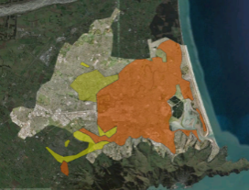
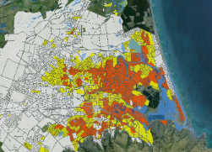
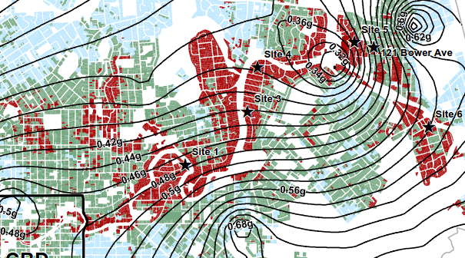
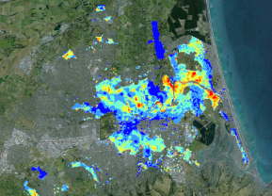



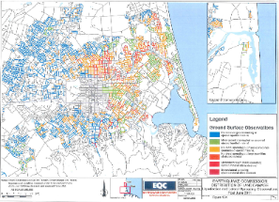
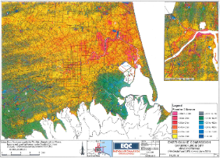
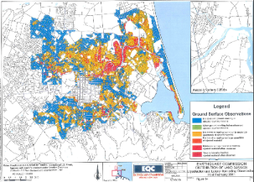
Experience From Christchurch Earthquake
PACIFIC DISASTER RESPONSE
WHAT DID WE DO FOR THE NZ GOVERNMENT & EQC IN CHRISTCHURCH?
Damage Maps
Helicopter Map
Fixed-wing Map
Satellite Photography
Aerial Photographs
Clear understanding of event
NZ aions
Drive-by Map
Foot-based Map
LiDAR

Slide 4
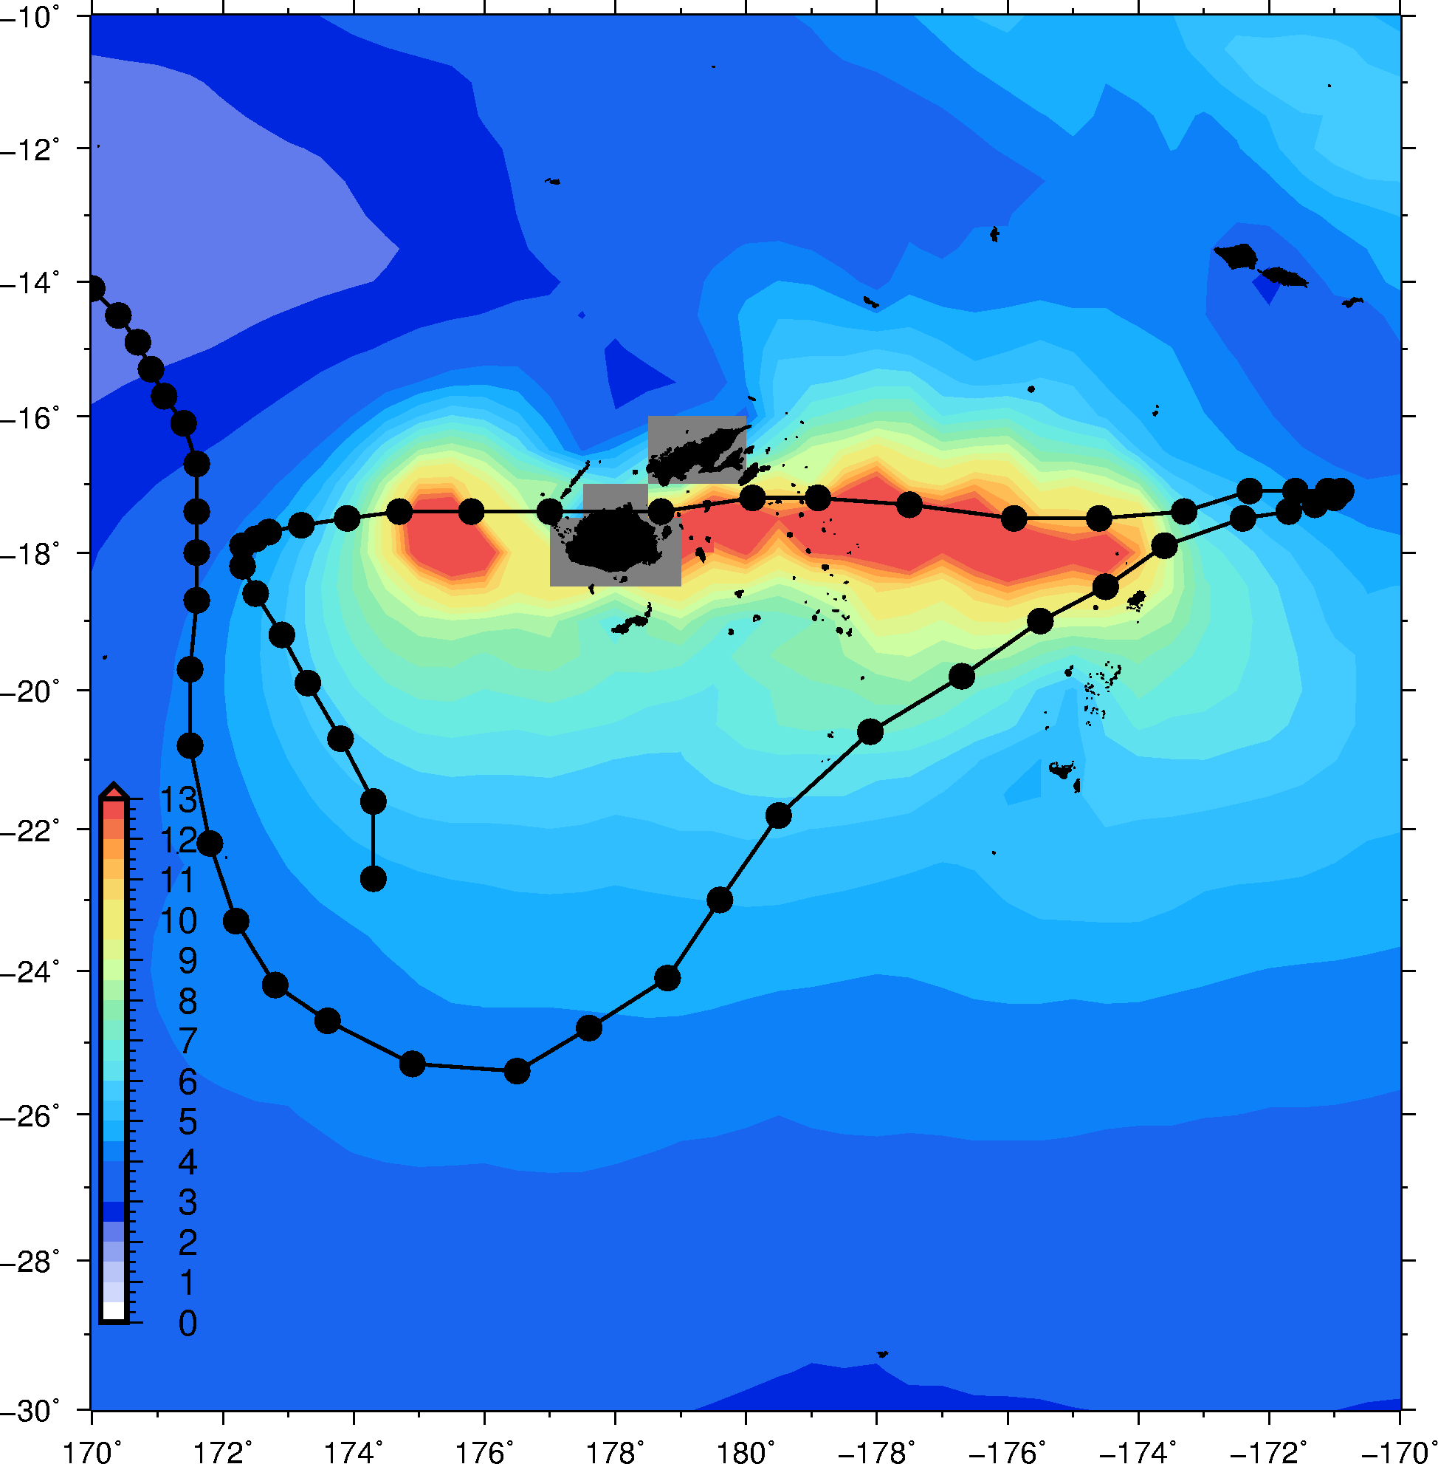
Experience From Cyclone Winston in Fiji
Sat Feb 20 ten-minute sustained winds of 230 km/h and a pressure of 915 hPa, shortly before making landfall on Viti Levu, Fiji.
Strongest tropical cyclone to make landfall over Fiji on record

Slide 5
What have we done in Fiji 2016?
Sourced reconnaissance imagery
Built GIS Portal
Regional scale building damage assessment
Supported aid agencies

Slide 6

Sun 21 Feb

Slide 7
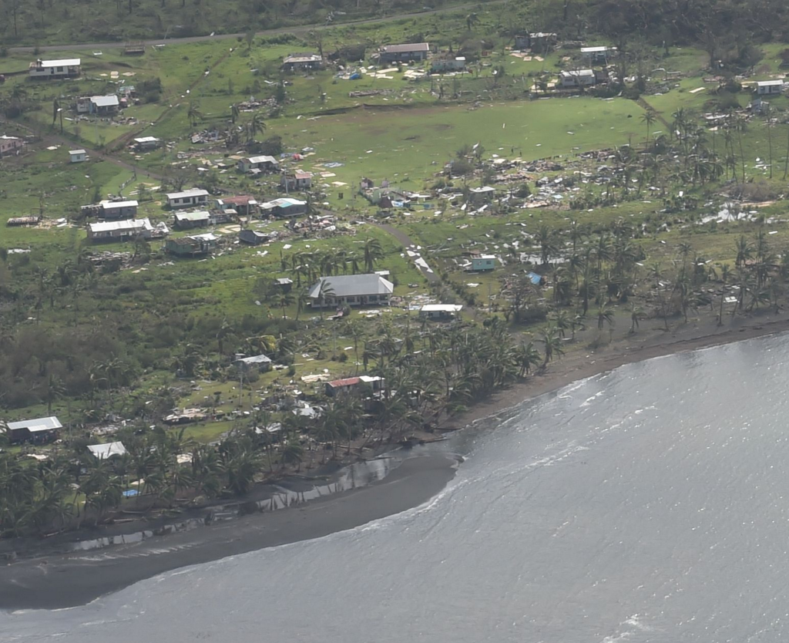
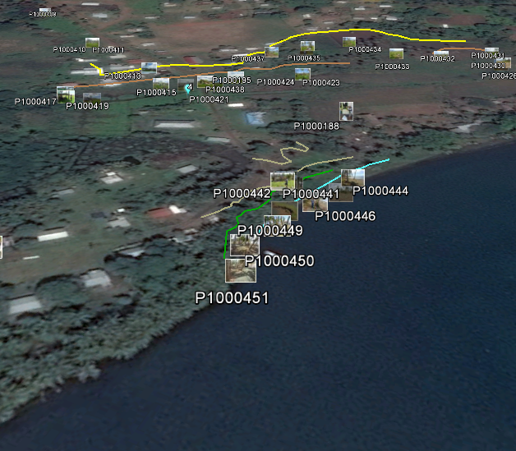

Slide 8
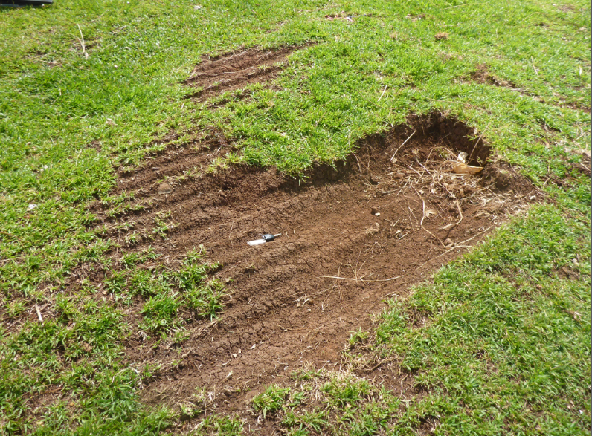

Slide 9
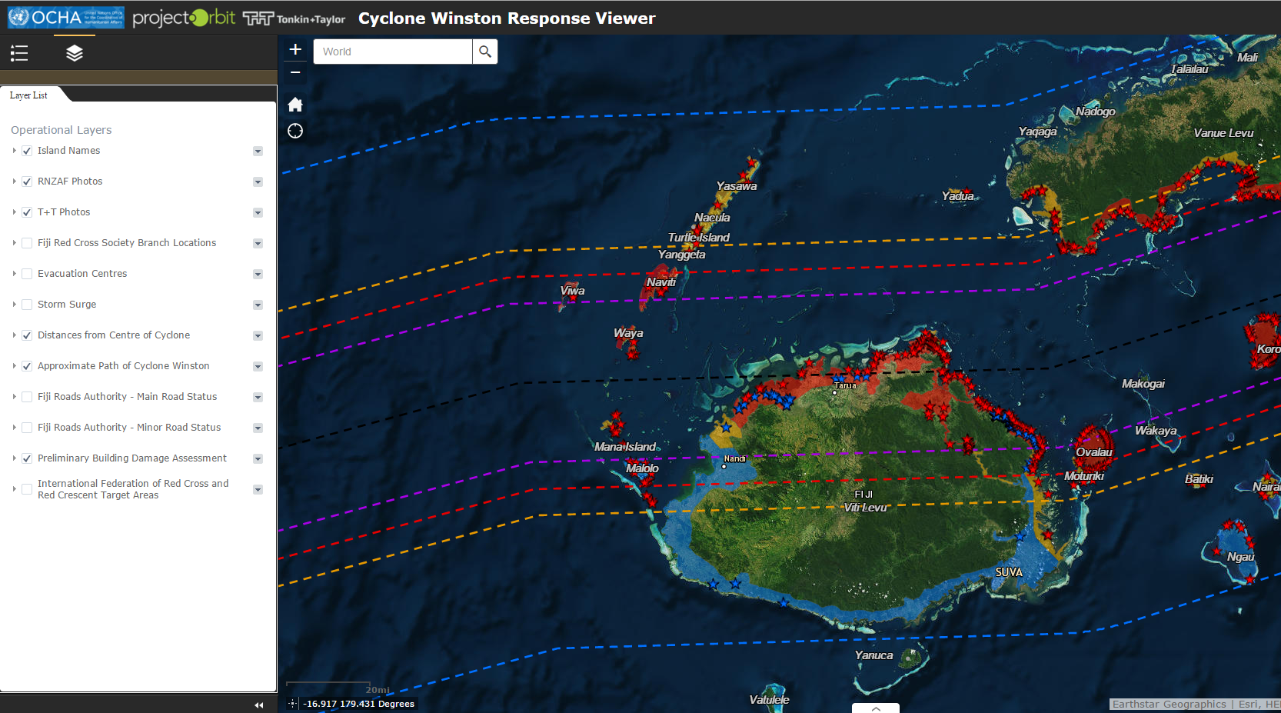
Experience From Cyclone Winston in Fiji
TC Winston - Orbit

Slide 10
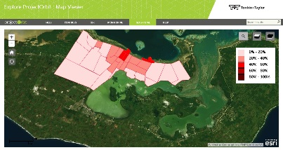
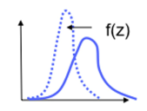
What We Need? Integrated System- Pre-Impact Assessment Framework
Severe Weather /wave/Storm surge forecast information/model
Risk Assessment
Statistical/ Probabilistic
Impact outlook and Response options for area under risk
Historical Hazards and damage information
Vulnerability Assessment
Web GIS Portal
Hazards Scenario Modeling
Demographic and socio-economic data base
Developed Fragility Functions for elements at risk

Slide 11
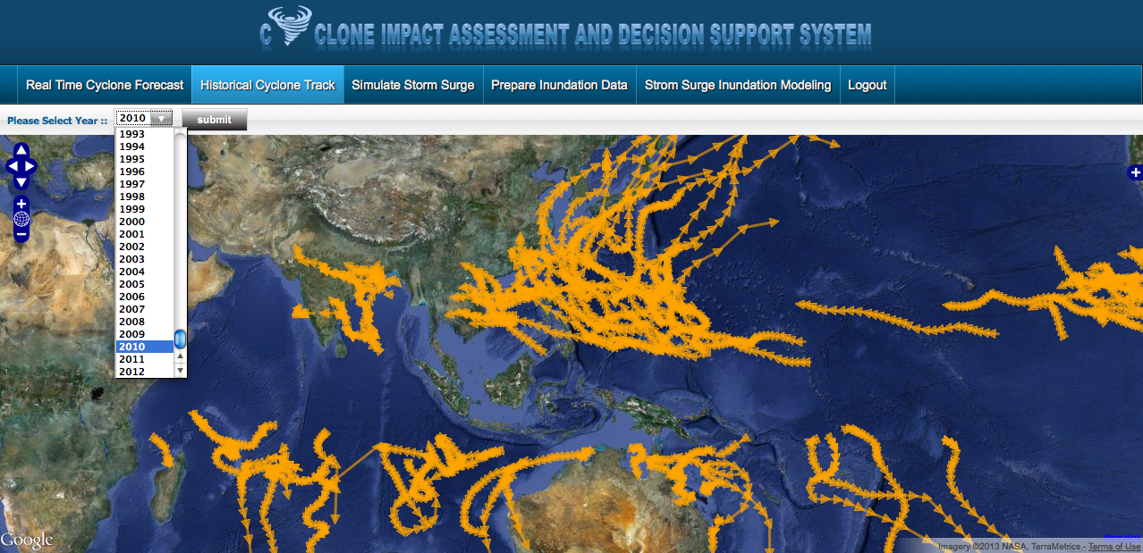
Pre-Impact assessment tools for natural hazards

Slide 12








1 – 7 Day Damage Mapping
1-7 day disaster reconnaissance program
Day -1
Day 0
Day 1
Day 2
Day 3
Day 4
Day 5
Day 6
Day 7
STANDBY & MONITOR HAZARD
ALERT
MOBILISE TO AREA AND MAP RISK
DAMAGE & RESOURCE MAPPING
RESPONSE MAPPING
RESPONSE MAPPING
Ongoing refinement of mapping & communication
INUNDATION
T+TOUTPUTS: Daily 8AM updates using open source web GIS collaborative platform
UPDATE:
Pre-disaster/Pre-impact mapping
Update Existing Hazard/Damage Relationships (Damage curves)
Coastal Inundation modelling
HAZARD MAP
RISK MAP
DAMAGE MAP
0.5m
1.0m
1.5m
0.5m
1.0m
1.5m
0.5m
1.0m
1.5m
Apply Pre-disaster/Pre-impact mapping
A
A
B
B
C
C
Requires Existing Info:
Pre-disaster/Pre-impact mapping
Existing Hazard/Damage Relationships (Damage curves)
Coastal Inundation modelling
Mobilise multi-disciplinary team engineering expertise
Liaise with NGO’s, Government
Stakeholders
RESOURCE MAP
RESPONSE MAP
0.5m
1.0m
1.5m
0.5m
1.0m
1.5m
A
A
B
B
C
C
Capacity of local government
Use of land
Asset base (Hospitals, shelter, drinking water)
Who is responding?
What are they doing?

Slide 13
Thanks

