Slide 1


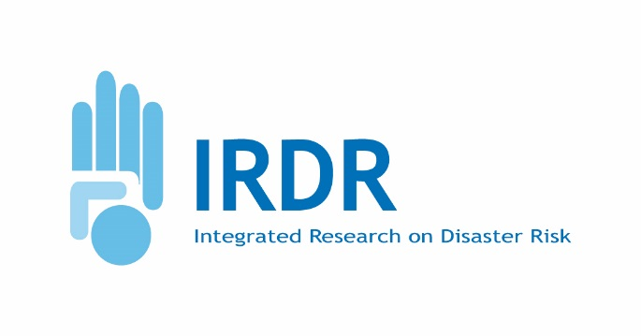

Disaster Loss Data (DATA)
Virginia Murray & Bapon Fakhruddin
16th Science Committee Meeting, Sanya, China
29-30 November 2016

Slide 2
Contents
The IRDR DATA project, in collaboration with CODATA and the Task Group on Linked Open Data for Global Disaster Risk Research, is building a network of networks to reflect the data requirements in the Sendai Framework.
DATA Goal
Recent Activities (From May – November 2016
Publications
Strategic Directions

Slide 3
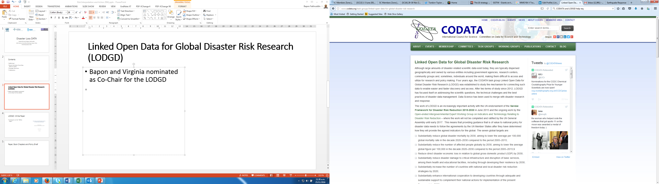
Linked Open Data for Global Disaster Risk Research (LODGD) of CODATA
Bapon and Virginia nominated as Co-Chair for the LODGD
Developed a research bid in partnership with LODGD which has been funded by CODATA (September 2016)

Slide 4

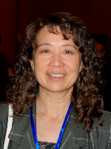
CODATA LODGD co-chairs
Guoqing Li
Institute of Remote Sensing and Digital Earth, China
Extensive knowledge and experience with remote sensing, spatial data infrastructure and disaster data management. Long time service in international organizations, such as CEOS, GEOSS, APN and ICSU. Now he is in the second term to serve as ICSU/WDS SC member.
Carol Song
Rosen Centre for Advance Computing, Purdue University, US
Extensive knowledge and experience with cyber infrastructure technology and information systems. Served as Chair of XD Service Provider Forum and advisory board member to NSF XSEDE. Principal investigator in various data centric research projects (drought information network, climate change impact on agriculture, global scale geospatial data GeoShare, and data infrastructure building blocks, etc).

Slide 5
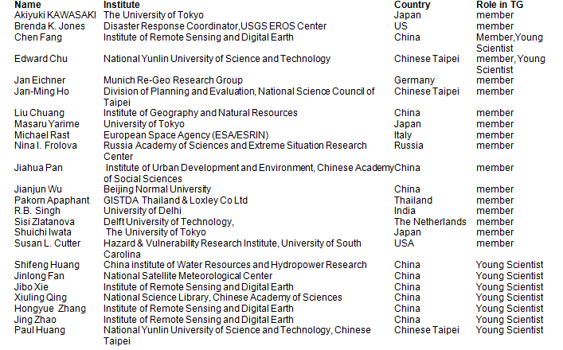

Slide 6
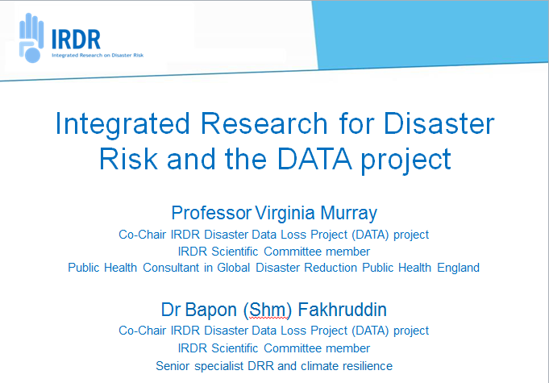
In partnership with CODATA IRDR presentation at Data loss project paper to the SciDataCon September 12-13, 2016

Slide 7
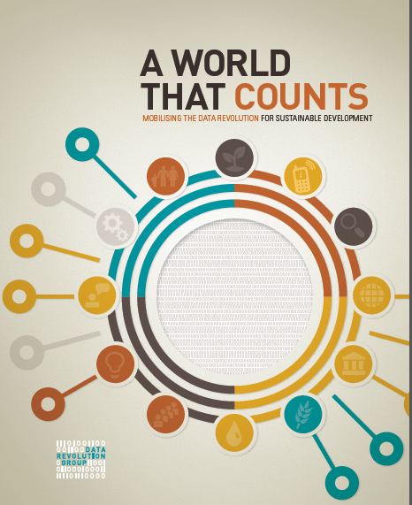

http://www.undatarevolution.org/wp-content/uploads/2014/11/A-World-That-Counts.pdf

Slide 8
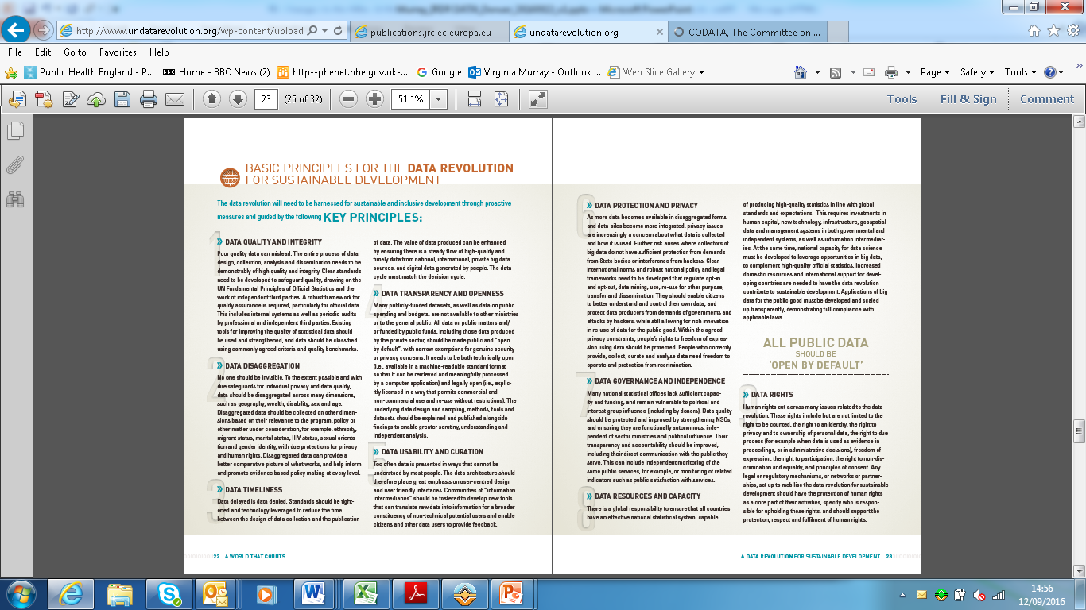

Slide 9
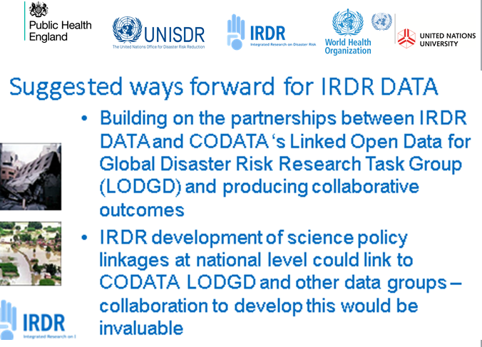

Slide 10
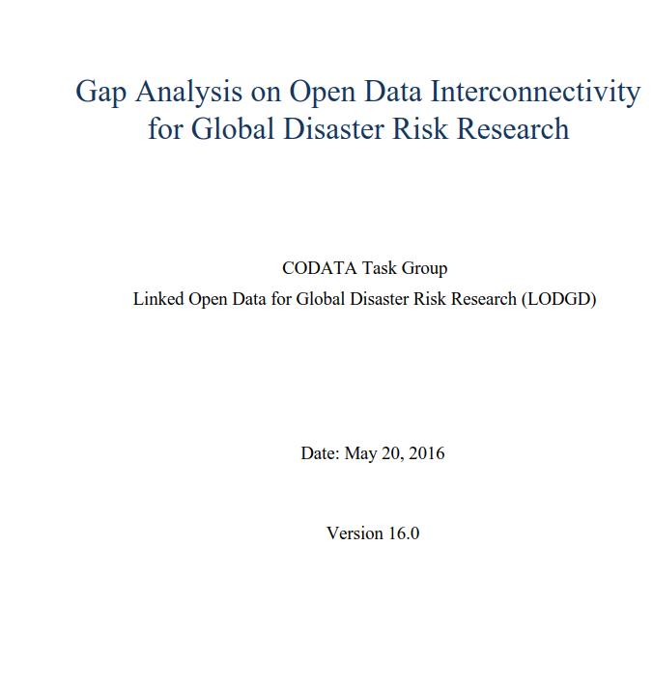
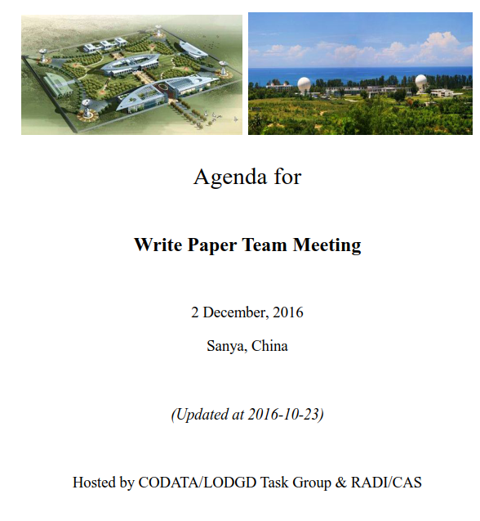
LODGD- White Paper
Comments on the “White Paper”. A memo has been issued to LODGD group on our overall comments.
Lack of inter-connectedness of the Sendai Framework with the SDGs and the Paris Climate Change agreement
Next meeting will be on 2nd December in Sanya

Slide 11
Task Group Outputs - 1
Second white paper on "Next Generation Disaster Data Infrastructure" is being drafted and will be finished in 2017.
Third white paper on “National Policy Study on Disaster Data around the World” will be undertaken.
In this phase, meetings for discussions of the white paper, internal reviews and external review. LODGD task group members will participate in relevant conferences. Consider holding workshops on linking open data for global disaster risk research (depending on the additional funding resources). Including:
Annual face-to-face meeting focusing on the LODGD group tasks.
Regular teleconference
Side-meetings at important conferences, such as SciDataCon, SciDataCon-China, ISDE, EOBAR, UNDP conference ,GEO plenary, IGU.
Joint training courses with CAS-TWAS SDIM, UNESCO-HIST as well as WDS.

Slide 12
Task Group Outputs - 2
Articles will be submitted by members to the CODATA’s Data Science Journal and other leading journals during the next two years.
The articles will share the research outcomes from this task group, with topics ranging from the
conceptual model and
design of new disaster data infrastructure,
methods for effectively and efficiently archiving and sharing historical disaster data,
mapping disaster vulnerability,
experience on developing linked open data applications on disaster mitigation, and
others that will emerge from the group's work.

Slide 13
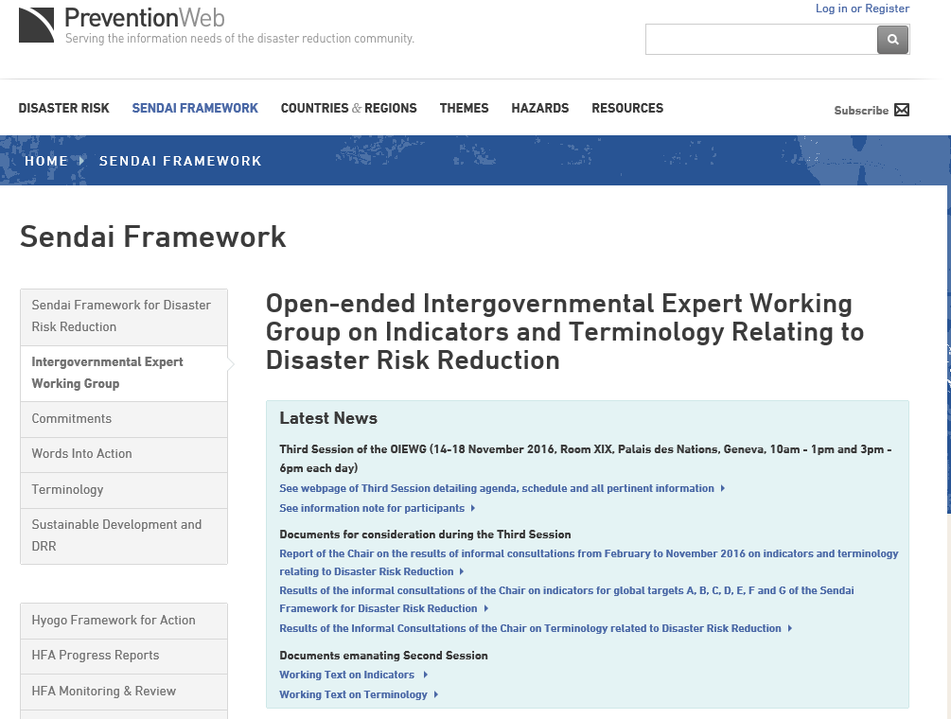

Slide 14
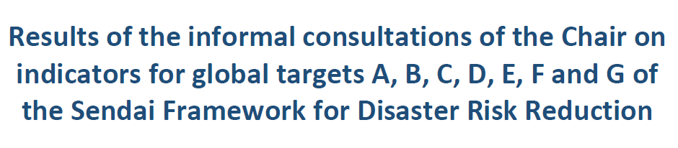
http://www.preventionweb.net/files/50683_resultsoftheinformalconsultationsof.pdf

Slide 15
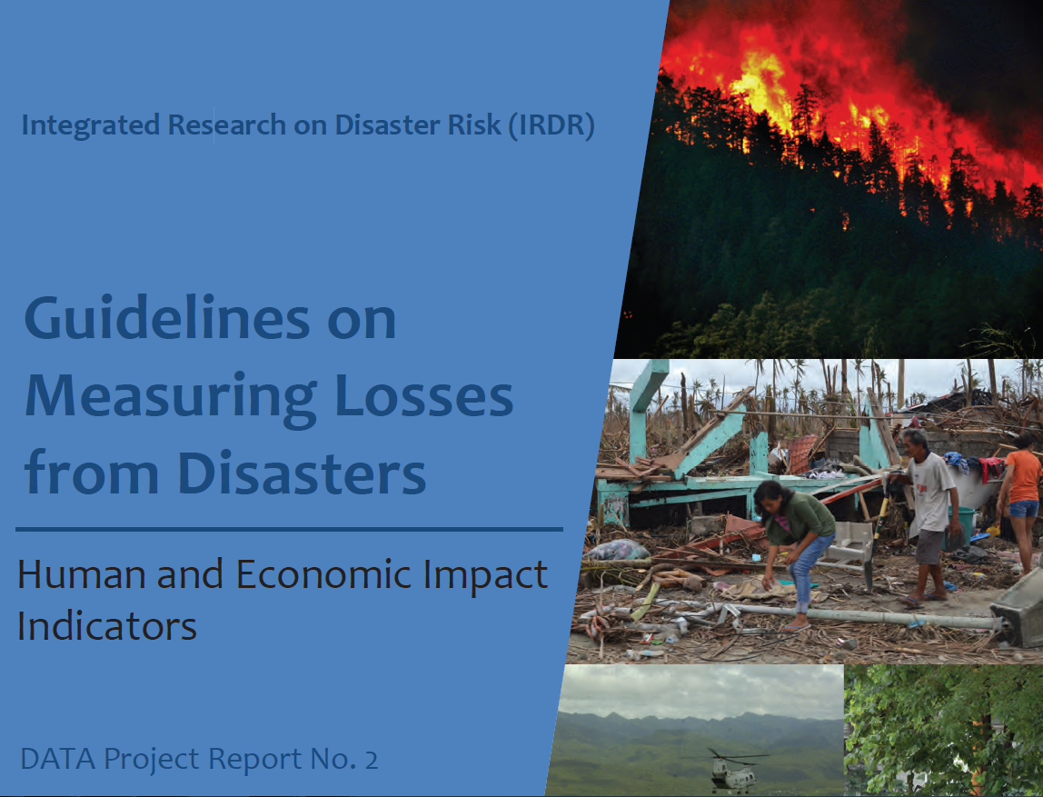
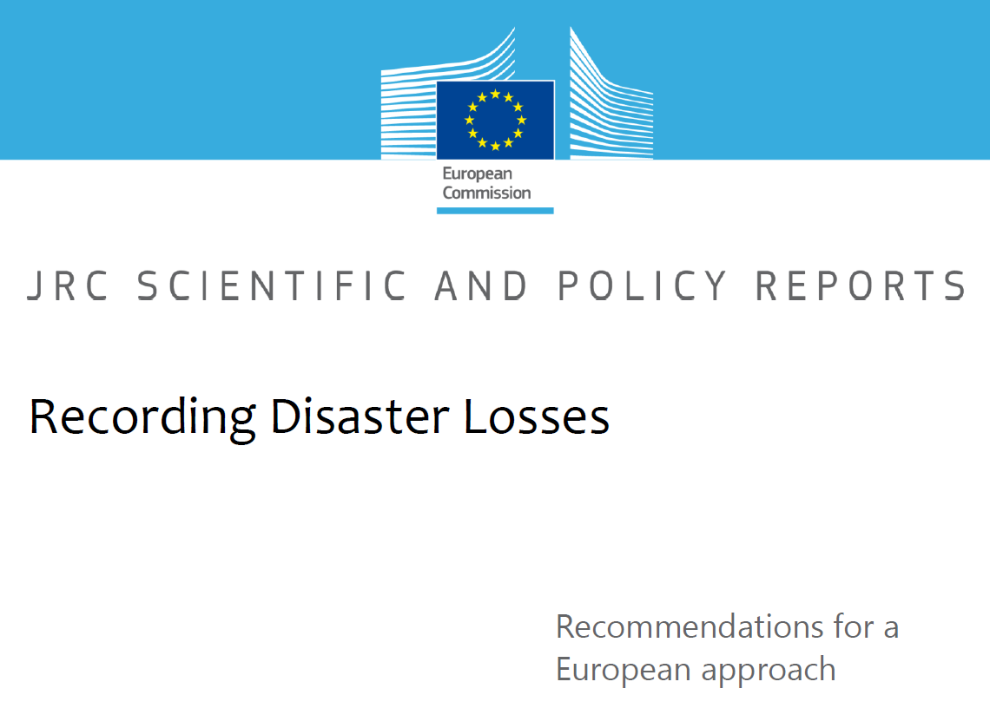
Paper, Book Chapters and Policy Brief
http://drr.jrc.ec.europa.eu/Portals/0/Loss/Recording%20Disaster%20Losses%20-%20Recommendations%20for%20a%20European%20Approach%20v4.3.pdf

Slide 16


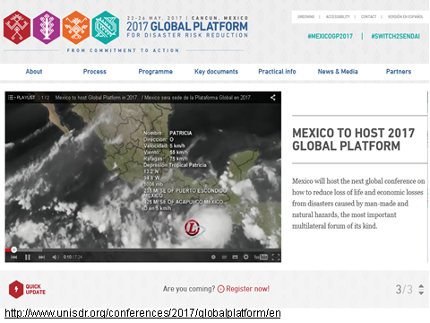
Strategic Direction

Slide 17
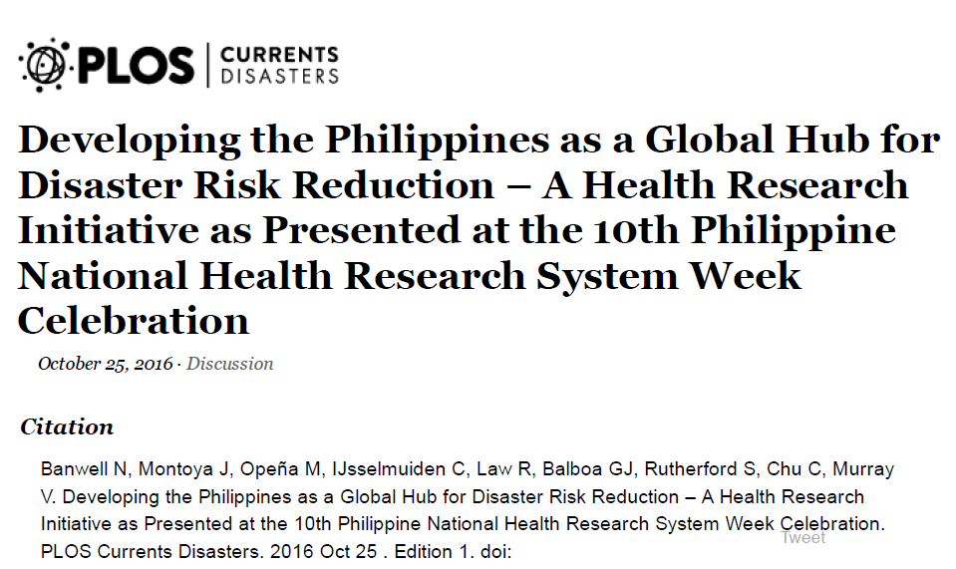
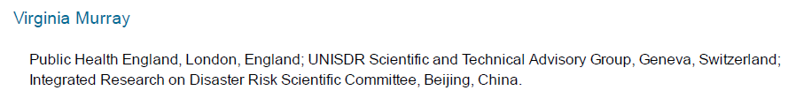

Slide 18
Research Gaps
Despite the gravity of flood damage and the importance of the agricultural sector, the process of assessing damages is limited.
There is no standard framework(e.g. Siva 2005, JRC 2015)
Notes:
Despite the gravity of flood damage and the importance of the agricultural sector, the process of assessing damages due to any natural disaster is limited. While many methods exist, there is no standard, introducing a high level of variation and subjectivity into the resulting assessment results. Oftentimes assessments are conducted in the direct aftermath of the disaster and do not take into account long term damages(e.g. Siva 2005, JRC 2015)

Slide 19
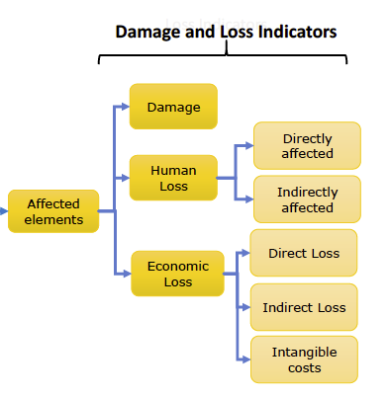
Research Gaps
Lack of holistic systematically collected disaster damage assessment and loss data globally for carrying out comparative studies (JRC 2015).
Risk assessment has not focused on probabilistic and consider the spatial and temporal uncertainties (Lane et al. 2011)
Lack of systematic assessment and measures at community level to limit potential flood damage to agriculture from extreme floods (Citeau, 2003)
JRC 2015

Slide 20
Strategic Direction
In the past, IRDR Data focused its effort on issues related to the collection, storage and dissemination of disaster loss data.
Need to reflect on indicators agreed
Proposed aim: “network of networks” to reflect the data requirements in the Sendai Framework,
data infrastructure for disaster research will connect disaster related datasets of observations, analyses, statistics, etc., from multiple scientific disciplines.
By linking to emerging research programmes it is hoped that this data will invite collaboration models using social media and citizen participation
Global Platform 2017, joint team-up with ICSU and IRDR for the disaster data and other thematic area.

