Slide 1


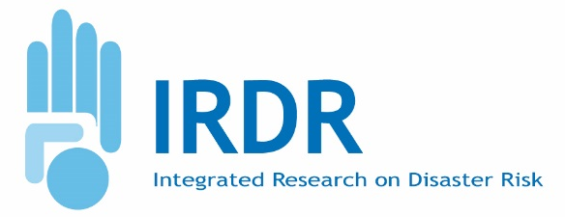

Risk Interpretation and Action (RIA)
Bapon Fakhruddin & Ann Bostrom
16th Science Committee Meeting, Sanya, China
29-30 November 2016

Slide 2
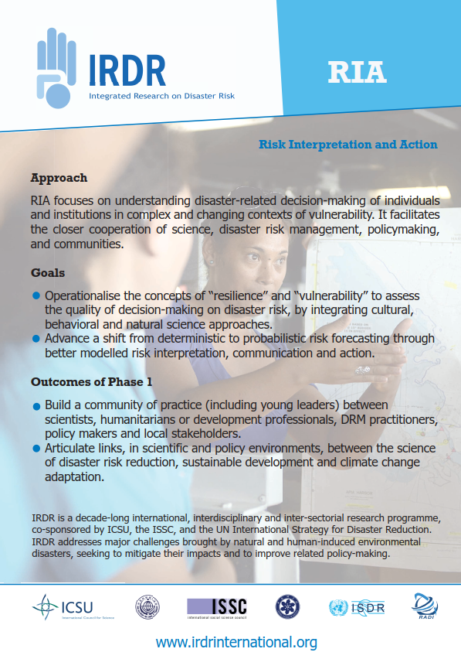
Contents
RIA Goals
Recent Activities (from May 2016 to the present; see also ICoE reports)
Strategic Directions
Publications

Slide 3
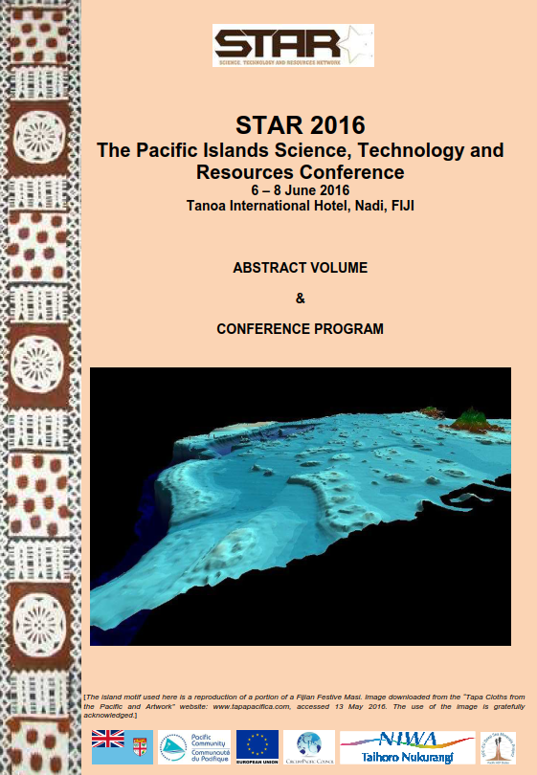
The Pacific Islands Science, Technology and Resources Conference
6-8 June 2016, Tanoa International Hotel, Nadi, Fiji
Conducted sessions on RIA and SFDRR.
Presented science applications to implement SFDRR Road maps
"Geosciences, Geo-engineering and the Ocean in the Pacific Islands Region"

Slide 4
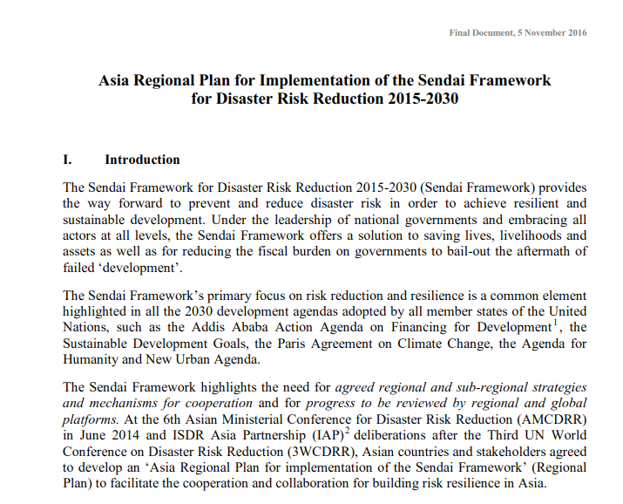
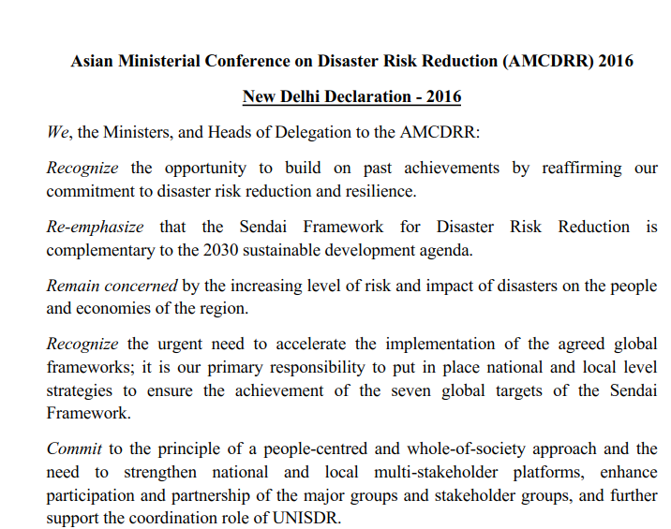
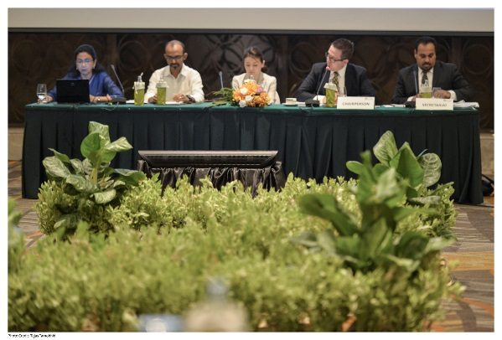
UNISDR IAP meeting in Bangkok
21-22 June 2016
Presented IRDR and RIA activities to IAP member countries
Contribution to the Asia Regional Plan (ARP)
Contributed to the Science-Policy Dialogue for Implementation of the SFDRR, 23-24 August 2016 and science and technology session for the AMCDRR in November 02-05.

Slide 5
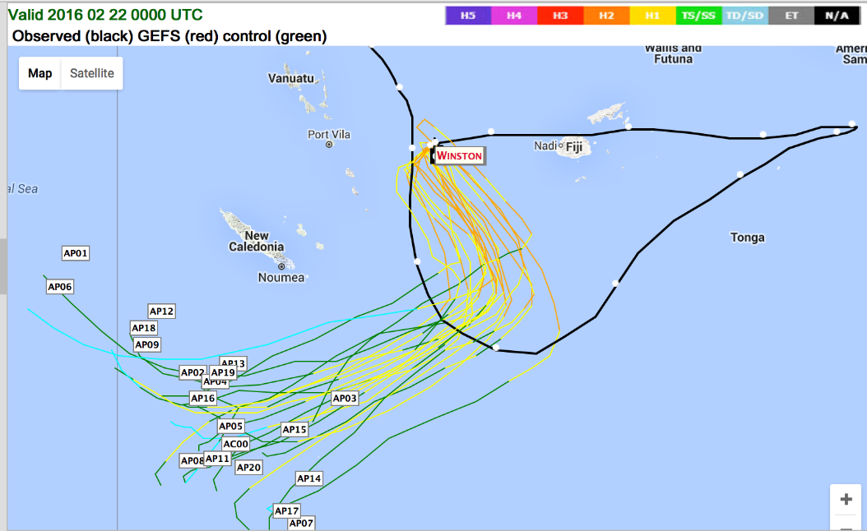
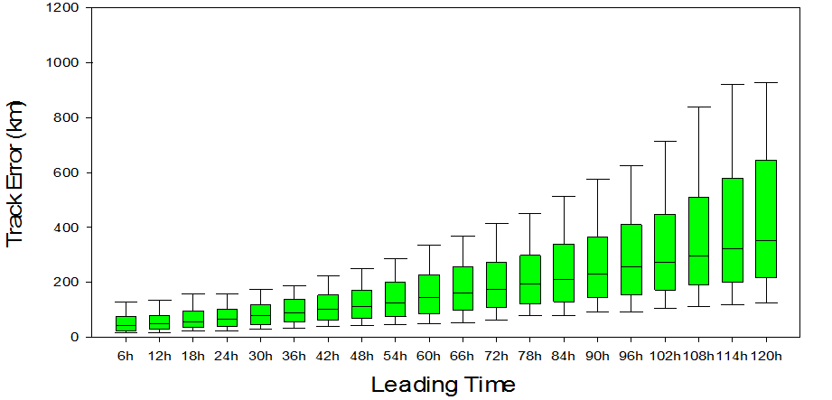
WMO RA V Tropical Cyclone Committee
Sixteenth Session, Honiara, Solomon Islands
29 August-2 September 2016
There is a need to explore the development of coastal impact forecasting caused by sea level inundation associated with tropical cyclones.
Storm surge and waves associated with tropical cyclones pose a real threat to coastal areas in the Pacific
Presented establishment of Cyclone early warning system.

Slide 6
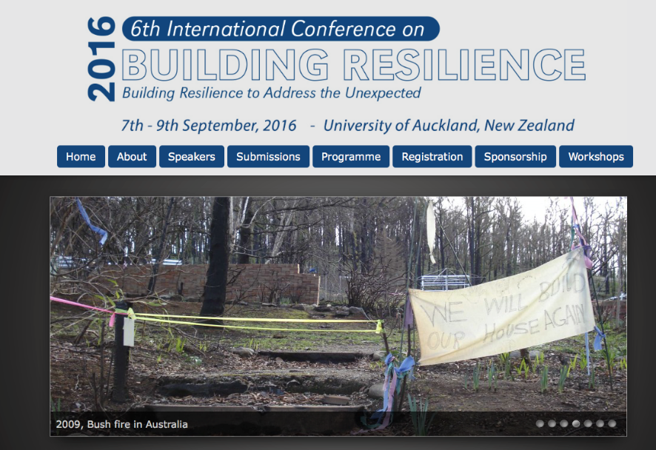
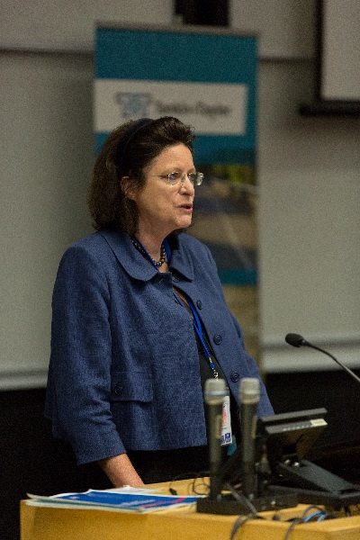
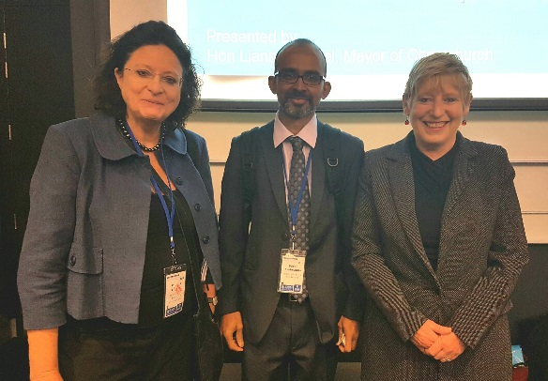
The 6th International Building Resilience Conference 2016
7-9 September 2016, Auckland, NZ
Prof Virginia Murray and I attended to provide the keynote, chair and present papers.
180 participants from more than 40 countries attended.
Conference to promote “Building Resilience to Address the Unexpected”
Findings are compiled in journal publication.

Slide 7
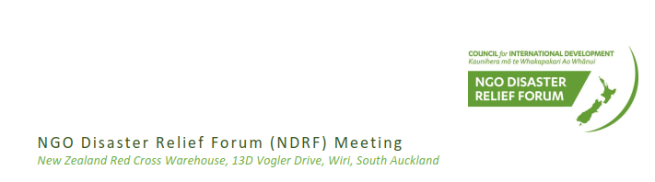
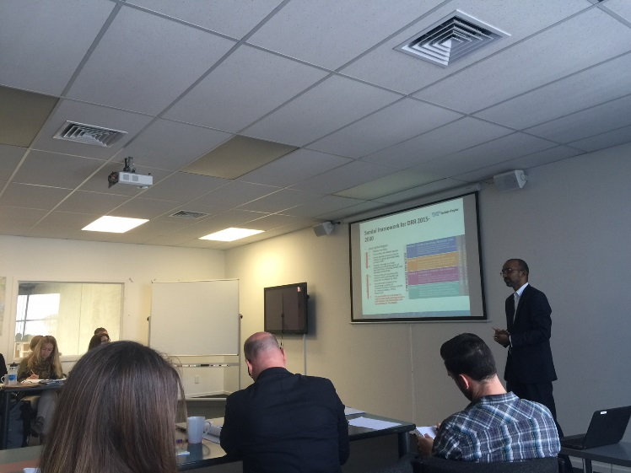
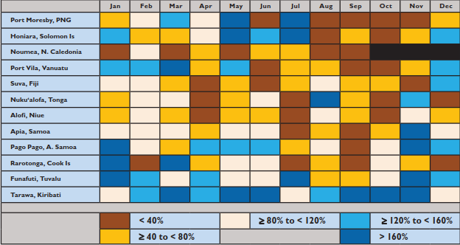
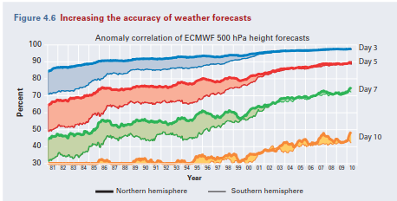
NGO Disaster Relief Forum (NDRF)
5 October 2016, Auckland, New Zealand
Presented IRDR and implementation of SFDRR
Implementation of a probabilistic early warning system for severe weather.
(BAMS, August 2016)

Slide 8
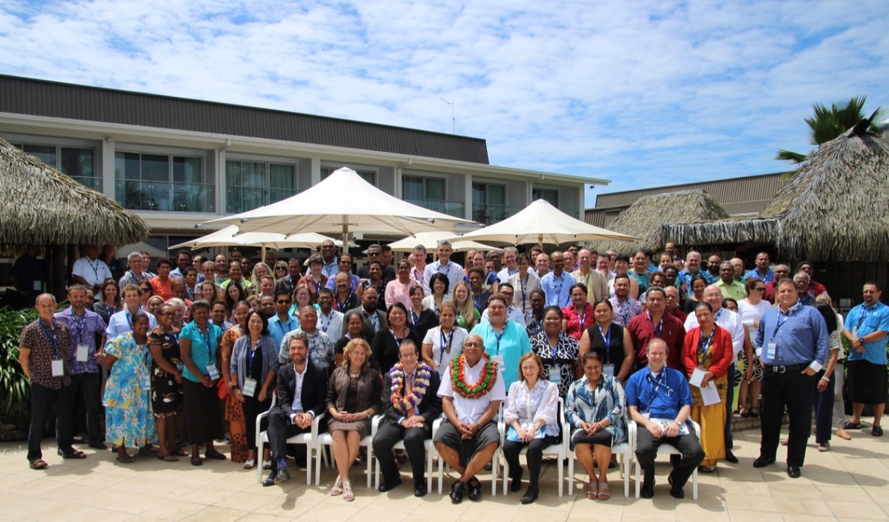
2016 Pacific Partnerships Forum
19-21 October 2016, Suva, Fiji
The Pacific Humanitarian Partnership meeting is the annual regional stakeholder meeting of the Pacific Humanitarian Team (PHT) and seeks to strengthen disaster-related partnerships and collaboration in the Pacific.

Slide 9
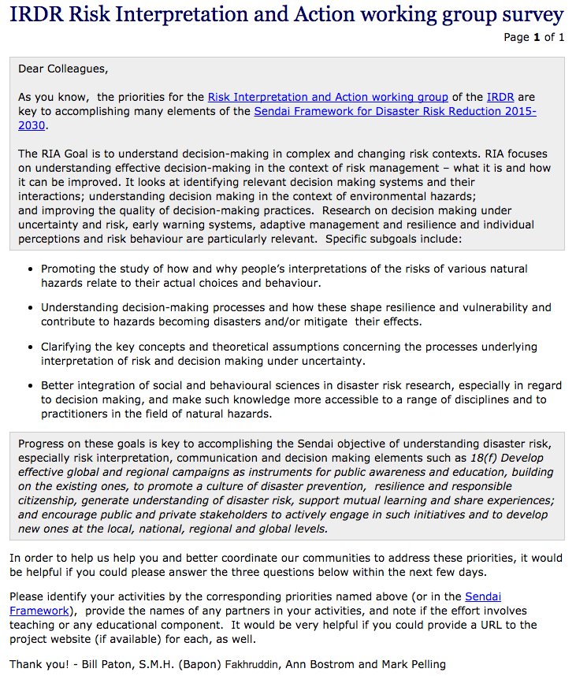
IRDR RIA Survey
Summer 2016
On behalf of the IRDR Risk Interpretation and Action (RIA) Project, we would like to invite you to complete our survey.
The survey's aim is to help identify coverage (and gaps) in high priority RIA elements of the Sendai Framework for Disaster Risk Reduction 2015-2030, enabling better co-ordination of our communities to address these priorities.

Slide 10
RIA Survey
What activities or projects have you completed recently (within the last year) that address these priorities? ​
For each activity/project completed in the last year (fill in as many as you have), please
identify the activity by the corresponding RIA priorities named above (or in the Sendai Framework),
provide the names of any partners in your activities, and
note if the effort involves teaching or any educational component, and
provide a URL to the project website (if available).

Slide 11
RIA Survey responses
Only 5 responses received, after multiple emails from IRDR (from China, Columbia, Latin America and the Caribbean, UK, US; two of these are from ICoEs, two from national government organizations).
Diverse projects, from 1 to 5 per respondent, e.g.: Integrating new science with policy planning; multi-hazard global probabilistic risk assessment for GAR; Developing city disaster risk management plans and programs; Reanalysis and completion of national weather and climate peril cost assessment; Studying how volcanic risk translates across borders; Disaster risk assessment along transboundary traffic corridors. Some educational efforts reported.
Relevance to Sendai framework: generate understanding of disaster, involve stakeholders, support action by local communities and authorities, support the interface between policy and science for decision-making.

Slide 12
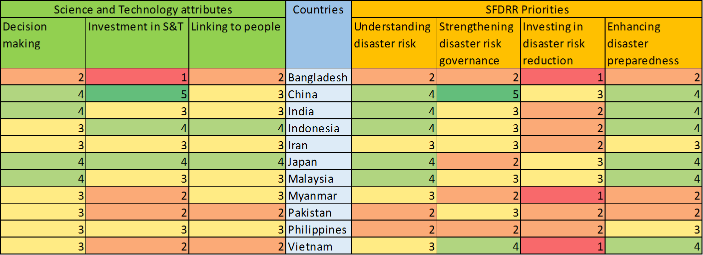
Strategic Directions
Asia S&T Status by IRDR, Future earth and ASTAAG, 2016

Slide 13
Strategic Directions

Slide 14
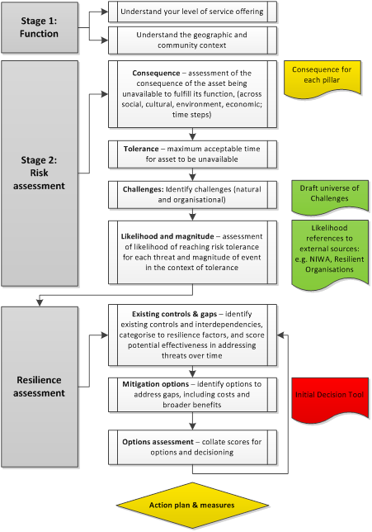
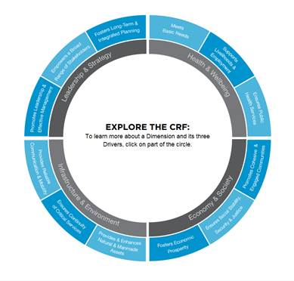
Strategic Directions
Operationalize “Resilience” and “Vulnerability”
Probabilistic vs. Deterministic early warning systems
Linking with other global/regional programs (e.g. 100 cities resilience)
Harvesting academic research to apply in operations
Lessons learned

Slide 15
Publications
Gibson T, Pelling M, Ghosh A, Matyas D, Siddiqi A, Solecki W, Johnson L, Kenney C, Johnson D, DuPlessis R (2016). Pathways for Transformation: Disaster Risk Management to Enhance Resilience to Extreme Events, Journal of Extreme Events. DOI: 10.1142/S2345737616710020 – based on research funded by ISDR for RIA
Lessons learned from 6th Disaster Conference outcomes.
Fakhruddin, S.H.M. Benefits of Economic Assessment of Cyclone Early Warning Systems - A Case Study on Cyclone Evan in Samoa. Environmental Science (2016 in-press).

Slide 16
Publications (continued)
Dunn, P.T., Ahn, Y.E., Bostrom, A. and Vidale, J.E. Perceptions of Earthquake Early Warnings on the U.S. West Coast. International Journal of Disaster Risk Reduction (accepted Nov 2016, forthcoming).
Bostrom, A., Böhm, G., O’Connor, R.E. Communicating Risks: Principles and Challenges. Chapter 13 in Lermer, E., Raue, M. and Streicher, B. (Eds). Psychological Aspects of Risk and Risk Analysis: Theory, Models, and Applications. Springer. (accepted Oct 2016, forthcoming 2017).
See also RIA ICoE reports

