Slide 1
IRDR-Data 1st Expert Working Group meeting in taipei
31 October – 2 November 2012

Slide 2
1st Expert Working Group Meeting
October 31 – November 2, 2012 in Taipei
Ms. Si-Yu Yu
IRDR International Centre of Excellence
Cell phone: 886-2-928-029530
E-mail: siyuyu@gate.sinica.edu.tw

Slide 3
1st Expert Working Group Meeting
October 31 – November 2, 2012 in Taipei
Introduction
The disaster data landscape is complex and the community that is dealing with loss data is rapidly growing.
When human, monetary, or environmental losses occur as a result of a disaster, extensive loss data are collected and stored by different organizations, but the thoroughness and accuracy of the data varies from country to country and even among local entities.
Government agencies, private companies, and other organizations may collect and manage data related to their own areas of interest using their own standards and procedures, without significant collaboration with other groups.
This result in gaps in the data, inconsistent overlaps, and biases that ultimately affect the quality of research conducted and policies made based on the data.

Slide 4
IRDR – Integrated Research on Disaster Risk
Working Group DATA Disaster Loss Data and Impact Assessment
Objectives
Identify what data and quality are needed to improve integrated disaster risk management
Bring together loss data stakeholders and utilize synergies
Have recognized standards, minimize uncertainty
Education of users regarding data interpretation and data biases
Ensure increased downscaling of loss data to sub-national geographies for policy makers
Definition of "losses" and creation of a methodology for assessing it
© 2012 Münchener Rückversicherungs-Gesellschaft, Geo Risks Research, NatCatSERVICE – October 2012

Slide 5
1st Expert Working Group Meeting
October 31 – November 2, 2012 in Taipei
Goals and Objectives
IRDR-DATA brings together stakeholders
from different disciplines and sectors to reconcile
some of these data issues in order to develop synergies
and collaborations in the production and utilization of disaster data.
The working group intends to establish an overall framework
for disaster loss data for all providers, to establish nodes and networks
for databases, and to conduct sensitivity testing among databases
to ensure some level of comparability.

Slide 6
1st Expert Working Group Meeting
October 31 – November 2, 2012 in Taipei
The specific objectives of DATA are:
Bring together loss data stakeholders and develop
synergies and capitalize on them
Identify the quality of existing data and what data are
needed to improve disaster risk management
Develop recognized standards or protocols to reduce
uncertainty in the data
Define “losses” and create transparent methodologies
for assessing it
Advocate for increased downscaling of loss data to
sub-national geographical levels for policy makers
Educate users regarding data interpretation and data biases

Slide 7
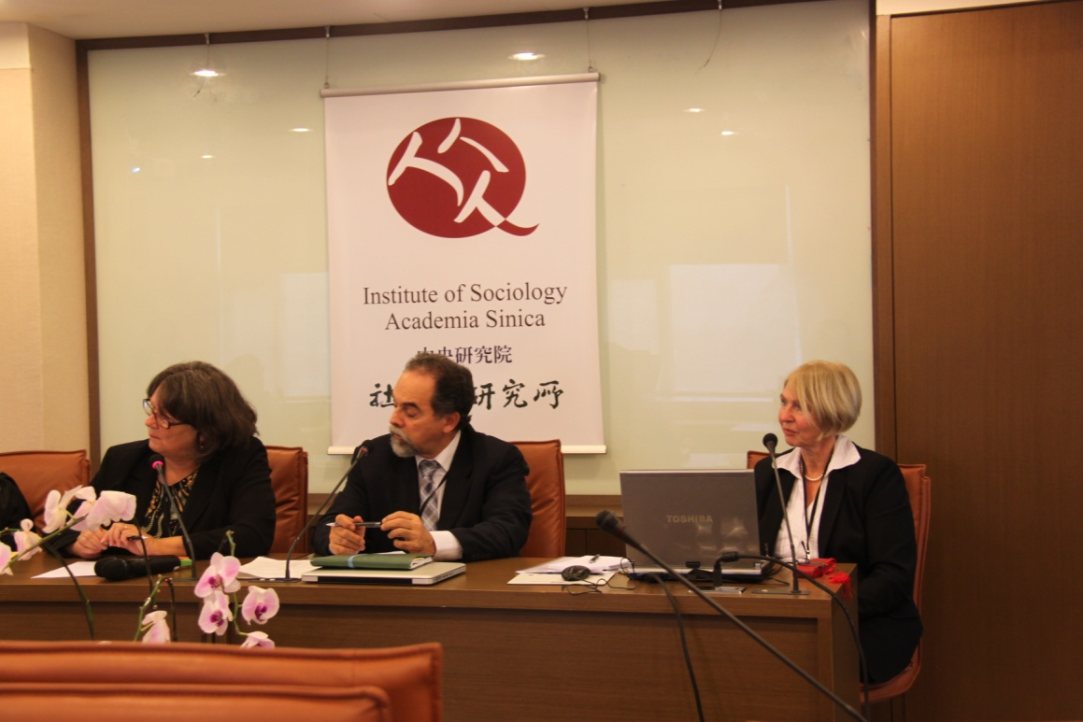
Day 1
Session 1 within 23rd CoData Conference
IRDR and the DATA Project to the Broader Community, was chaired by IRDR Chair Salvano Brisceno who provided the introduction on IRDR and IRDR data.
Presentations by DATA co-chairs
Angelika Wirtz - The Data Landscape
Susan Cutter - The Need for Data

Slide 8
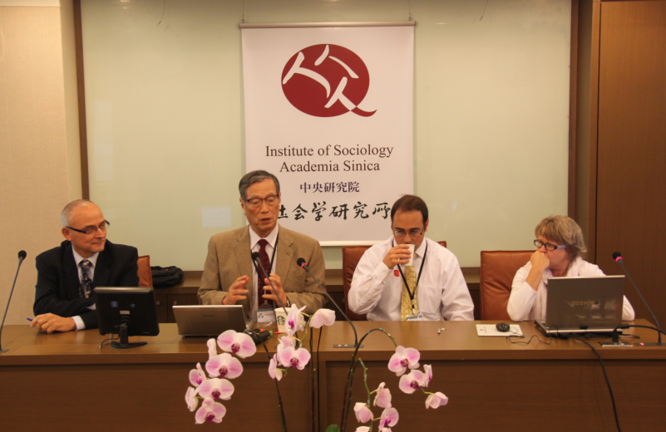
Day 1
Session 2 - Global Perspectives on Disaster Databases
Chaired by Kuniyoshi Takeuchi
Regina Below: Em-Dat: The Global Disaster Loss Database
Daniele Ehrlich: The Importance of Disaster Loss Data from the EU Perspective
Adam Smith: Disaster Loss Data from a County Perspective

Slide 9
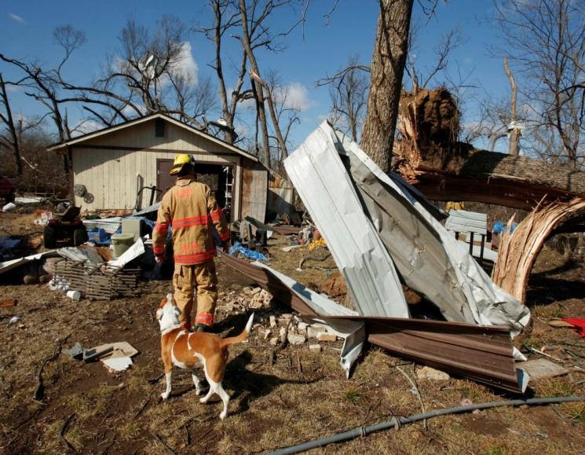
Day 2 and 3
The agenda was focused on three broad areas:
Current context of disaster loss data from global to local (needs, gaps, weaknesses, strengths, availability);
Improvements in current disaster loss data and what data are needed to improve disaster risk management;
Data issues for disaster impact assessment.

Slide 10
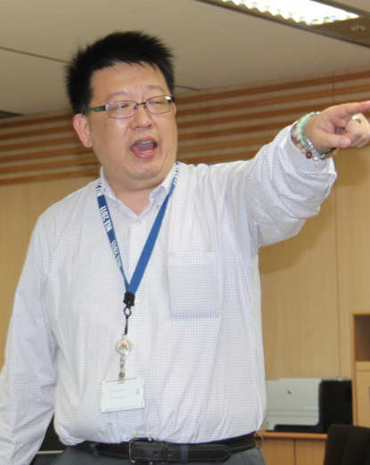
Day 3
The participants also made a site visit to the National Science and Technology Center for Disaster Reduction (NCDR) in Taipei and were briefed on their activities in support of disaster management and emergency preparedness for Taiwan.

Slide 11
1st Expert Working Group Meeting
October 31 – November 2, 2012 in Taipei
Regina Below | CRED | Belgium
Lucia Bevere | Swiss Re | Switzerland
Salvano Briceno | IRDR | Switzerland
Robert Chen | Columbia University | USA
Susan Cutter | University of South Carolina | USA
Daniel Ehrlich | EC Joint Research Centre | Italy
Wei-Sen Li | National S&T Center for Disaster Reduction | Taipei
Mustapha Mokkrane | World Data System | Japan
Maria Patek | Government Austria | Austria
Kiyoshi Natori | Asian Disaster Reduction Center | Japan
Adam Smith | National Climatic Data Center, NOAA | USA
Kuniyoshi Takeuchi | International Centre for Water Hazard Risk Management | Japan
Wirtz Angelika | Munich Re | Germany
© 2012 Münchener Rückversicherungs-Gesellschaft, Geo Risks Research, NatCatSERVICE – October 2012
Notes:
Header:
Handout:
Trainer:

Slide 12
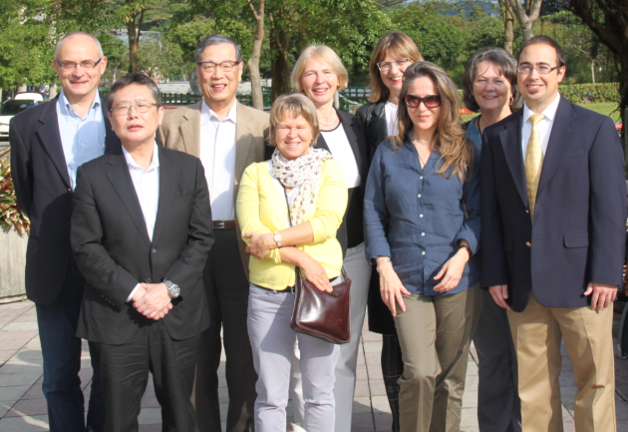
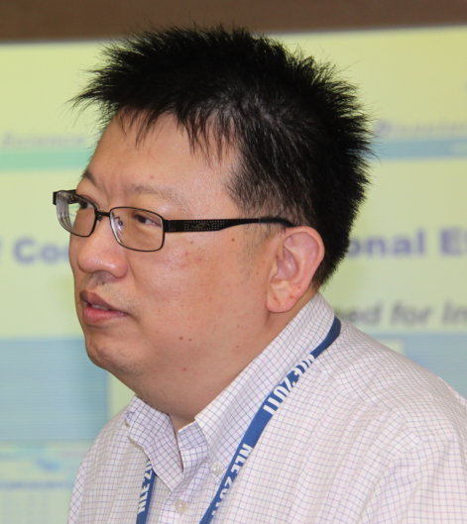
1st Expert Working Group Meeting
October 31 – November 2, 2012 in Taipei
Participants

Slide 13
1st Expert Working Group Meeting
October 31 – November 2, 2012 in Taipei
Approval of DATA WG members.
Formally constitute the WG with a core membership of interested and experienced data providers, compilers and users.
We anticipate that as topics vary the core membership will be enhanced by subject matter expertise as needed.
The flexibility in the membership enables the DATA WG to be responsive to changes in the data landscape caused by improvements in data collection, methodologies, and technologies for database management.
One the core membership has been approved by IRDR Science Committee it will be posted to the website along with the goals and work plan for 2013-2014.
Timeline: December 2012

Slide 14
1st Expert Working Group Meeting
October 31 – November 2, 2012 in Taipei
Establish a list-serve for DATA WG.
To facilitate communication about technical database issues,
exchange of ideas and queries about database compilation,
and a list serve will be established for core members of the WG.
Timeline: December 2012

Slide 15
1st Expert Working Group Meeting
October 31 – November 2, 2012 in Taipei
2nd WG Meeting in April 2013.
Two shorter term action items were identified
The first is the need to evaluate the existing peril terminology and hierarchy put together by CRED, UNDP, DesInventar, MunichRe, Swiss RE and ADRC and then endorse such a framework by IRDR/ICSU.
We are well along on this process and with an additional day of meeting such a framework can be finalized and become a public document and output from the DATA working group.
WG members would be provided with preparatory information (briefing paper already in existence from CRED), sample of database implementation, difficult cases examples, and a short white paper on specific technical issues.
Deliverable: endorsed framework for peril classification for
use by major data compilers

Slide 16
1st Expert Working Group Meeting
October 31 – November 2, 2012 in Taipei
Second: Improvement in GLIDE numbering system of disaster events. There are some issues on the need for enhancements in the current GLIDE unique identifier of events and
whether such a system should be a database, and informational source, or just a cataloging system. The WG has some ideas on how to improve GLIDE and how it could serve as a platform for linking other data on specific disasters such as FORIN research outputs. A one-day meeting to produce a requirements document on what such a system should entail is proposed. The WG is hopeful that such a requirements document generated by IRDR can help provide the leverage for new directions and financial stability in the present GLIDE program.
Deliverable: requirements document for enhancements of present GLIDE system

Slide 17
1st Expert Working Group Meeting
October 31 – November 2, 2012 in Taipei
Assessing human impact and methodologies for economic impacts.
There are longer term issues with inconsistencies in how human impact is measured and some new opportunities for assessing number of people affected by disasters.
As part of the 2nd meeting, we will explore these in more detail and develop an action-oriented agenda on measurement for both human impact and economic loss assessment methodologies as part of the agenda on the third day.
Timeline: April 2013

Slide 18
1st Expert Working Group Meeting
October 31 – November 2, 2012 in Taipei
Catalog of existing methodologies/research on measuring economic impacts.
In preparation for the action plan for 2013-2014, we need some bibliographic work conducted on the present state of knowledge on methodologies for measuring economic impacts specifically and disaster impact assessment more broadly. This small project would be conducted by students working under the supervision of the WG Co-Chairs.
Timeline: January-October 2013
Deliverable: Annotated bibliography available on IRDR web site.

Slide 19
1st Expert Working Group Meeting
October 31 – November 2, 2012 in Taipei
3rd Working Group meeting.
Continue to focus on clearer definitions of human impact and economic impact methods.
Also begin preparatory efforts to encourage the development of national and subnational disaster loss databases as part of the negotiations for 2015 Hyogo Framework meeting.
Procedures and criteria for the development of pilot national databases will be determined.
Implementation of a demonstration project will be conducted in 2014 and presented in Hyogo in 2015.
Timeline: Fall 2013

Slide 20
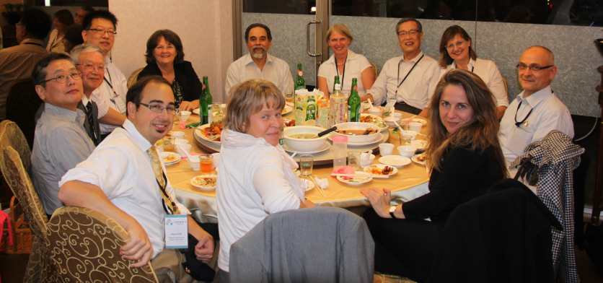
1st Expert Working Group Meeting
October 31 – November 2, 2012 in Taipei

