Slide 1
GEM/IRDR Social Vulnerability and Resilience Information System and Metadata Portal
IRDR Scientific Board Meeting
Chengdu
03/11/2012
Notes:
Aim of the presentation: present a tool which is able to dynamically organize a complex knowledge domain: deconstruct this knowledge into some core constructs, put it into a structure which is generated endemic from this research field based on literature and peer discussions
So just one comment in advance: this wiki has been developed by researchers coming from different disciplines but concerning informational science we are all lay people concerning informational science.

Slide 2
Background
Measurement of vulnerability/resilience is a key step towards disaster risk reduction.
The development of universal metrics remains a challenge.
No centralized information source exists (data, methods, research initiatives, theory, ancillary information).
Objective
Implementation of an information system aimed specifically at global, regional, and locally-based assessments.
Provision of a common platform for knowledge integration and sharing.
Development of a uniform ontology and taxonomy allowing the annotation of key categories
Provision of a dissemination source for various IRDR initiatives, e.g. AIRDR, etc.
Notes:
--Development of universal metrics for measurement remains a challenge due to the ever-present definitional ambiguity of the concepts, the dynamic nature of their components, and changing scales of analysis (temporal and spatial).
--In addition, various issues related to data availability and knowledge integration exist.
--There is currently no centralized information source that focuses explicitly on data, methods, current and past research initiatives, theory, and ancillary information that may be helpful for researchers and risk managers to better understand and measure social vulnerability and resilience using bottom-up, regional, and contextually specific approaches.
OBJECTIVES
--To provide a common platform integration of knowledge and theory that includes data identification and retrieval capabilities, access to key literature and resources pertinent to the field.
--Develop a uniform ontology that allows the annotation of key categories and properties of vulnerability, so that they can be made comparable and easily accessible at a glance

Slide 3
Conceptual Framework
Source Information, Data, Metadata
Research Initiatives
Information Portal
Client
Ancillary Sources/Dissemination Systems
Notes:
--A common platform will be developed to integrate and facilitate the dissemination of information to promote data identification, access, interoperability, and the sharing of key sources of information on social vulnerability and resilience throughout the world. The project will identify and link to experts, institutions, and programs that focus on social vulnerability assessments, and it is intended that the work will utilize existing information portals to leverage their database design and information-sharing standards.

Slide 4
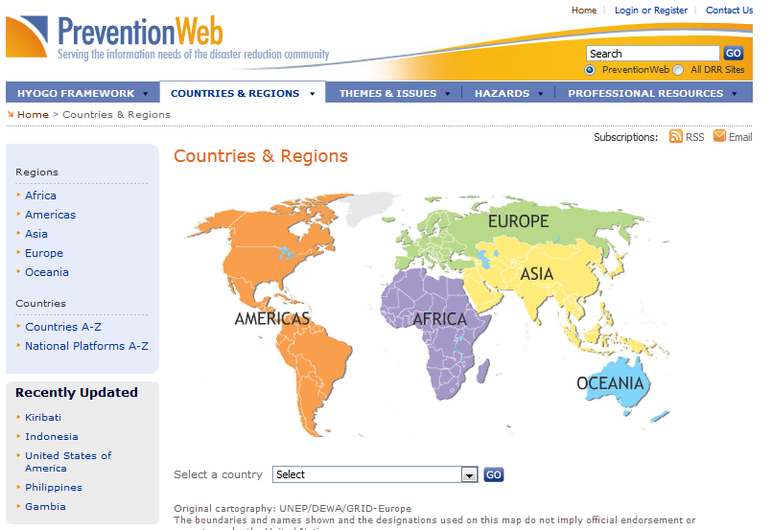
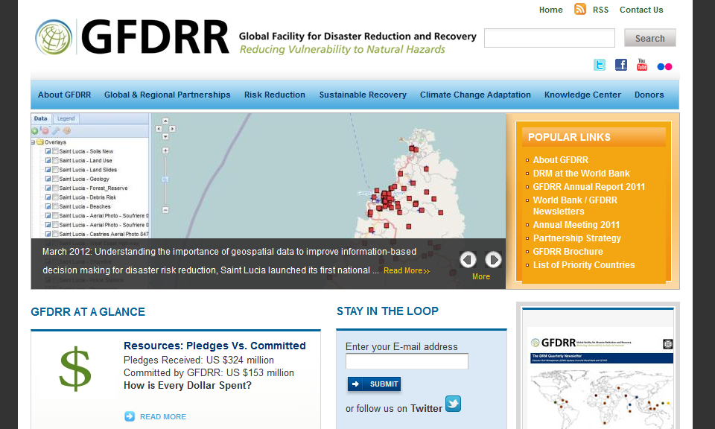
Database Sources /Structure
Notes:
--These systems include the adoption and further development upon the Karlsruhe Institute of Technology’s Vuwiki (www.vuwiki.org) framework and database due to its ontology and taxonomy based information storing and retrieval structure as well as the use of UNISDR’s PreventionWeb platform (www.preventionweb.net) to facilitate widespread exposure and knowledge-base utilization.
--Such resources provide a pathway for information submission, information dissemination, and the means to overcome some of the challenges inherent with collection and dissemination of data, namely the necessity to maintain large and centralized databases and the inefficiency of relying on a single source agency to collect data in a consistent way that is useful to those needing it.

Slide 5
Getting us there
Survey of of existing literature, data, models, and methods
For compilation into web-based framework and into ontology and taxonomy model
Development of web-based framework, ontology, semantic wiki
To provide a methodology for the description of methods, data, frameworks, etc. and to allow for the classification of approaches and concepts via a structured and rational manner.
Development of information and data drilldown tools
To make all resources within ontology and taxonomy model available via the web using drilldown tools utilized to filter information based on selectable criteria
Notes:
1) The review will be conducted under the premise that the goal of this project is the facilitation of the production of metrics and operational tools for the assessment of the social vulnerability and resilience of populations at regional, national, sub-national, local levels of geography.
2) The ontology will be implemented into a web-based semantic wiki which allows for the classification and annotation of assessment methods that have already been applied in the literature.
--The aim will be to develop a uniform ontology that allows web-based query, annotation, and visualization of key categories and properties of vulnerability and resilience studies, data, and metadata so that the content is comparable
3) All resources within the ontology and taxonomy model will be made available via the web using drilldown tools utilized to filter information based on selectable criteria. Users, for instance, will be allowed select information based on individual queries, via the use of menu options that provide selection from main categories (e.g. data, theoretical frameworks, or assessment standards), or from sub-categorizations such as qualitative or quantitative assessment methods.
--The work will be extended to allow users to search and compare information through the use of dynamic tables, forms, and filters, and a step-by-step information input form will be provided to facilitate the enrichment of the accompanying database through the addition of additional studies, data sources, and information.
--Links to specific data sources, where applicable and available, will be attainable via country, regional, and spatial selection

Slide 6
What is an Ontology?
“An ontology […] is a formal representation of technical concepts and their interrelations in a form that supports domain knowledge. Generally, an ontology is hierarchical, with child concepts having explicit properties to specialize the parent concept(s)” (Raskin & Pan 2005: 1120).
Common components include
Individuals: instances or objects (the basic or "ground level" objects)
Classes: sets, collections, concepts, classes in programming, types of objects, or kinds of things
Attributes: aspects, properties, features, characteristics, or parameters that objects (and classes) can have
Relations: ways in which classes and individuals can be related to one another.
Notes:
Scalability = easily extendable to enable specialized domains to build upon more general ontologies already generated.
Application‐independence = structure and contents are based upon the inherent knowledge of the discipline, rather than on how the domain knowledge is used.
3) Natural language‐independence = provide a representation of concepts, rather than of terms. The concepts remain the same regardless of the inclusion of slang, technical jargon, foreign languages
4) Orthogonality = compound concepts should be decomposed into their component parts, to make it easy to recombine concepts in new ways
5) Community involvement = Community input should guide the development of any ontology

Slide 7
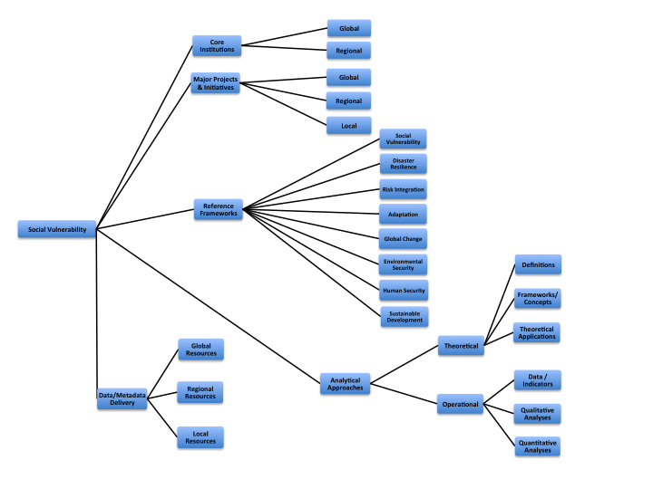

Slide 8
What is a Semantic Wiki?
Conventional wikis:
…collect and share knowledge
…are good for storing and retrieving individual information, but not for aggregated or queried information
…are not machine-interoperable and weakly structured
Semantic wikis:
…allow to organize categories hierarchically and thus improve consistency of content
…are structured by an ontology which could be understood as a hierarchical representation of concepts and their interrelations in a certain knowledge domain
Semantic annotations are added allowing the wiki to function as a collaborative database

Slide 9
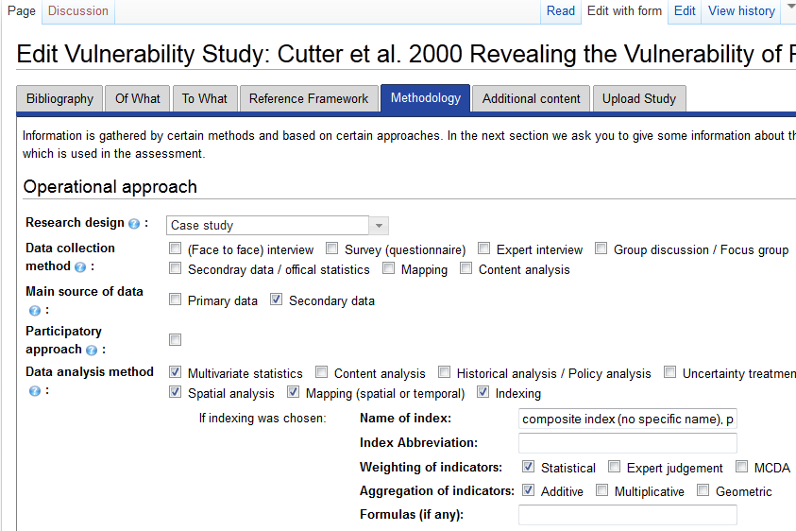
Add an Assessment by Semantic Form
Wegner and Khazai 2012

Slide 10
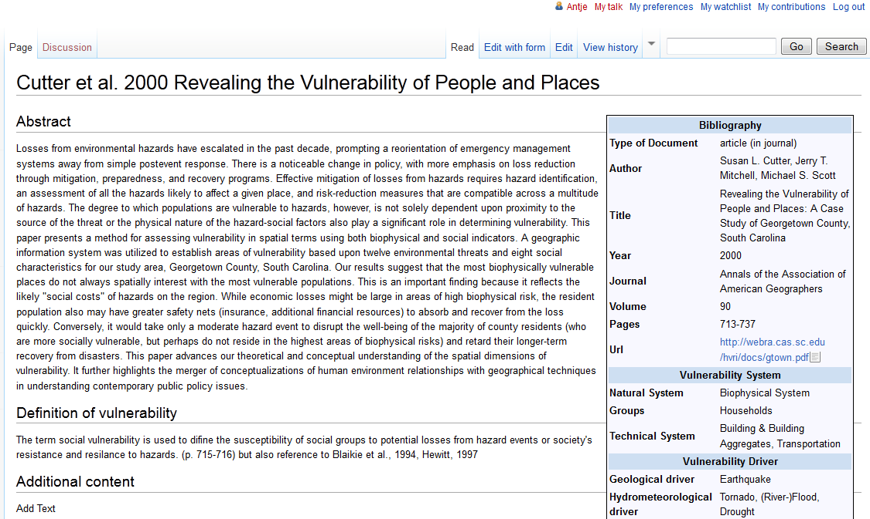
The Result
Wegner and Khazai 2012

Slide 11
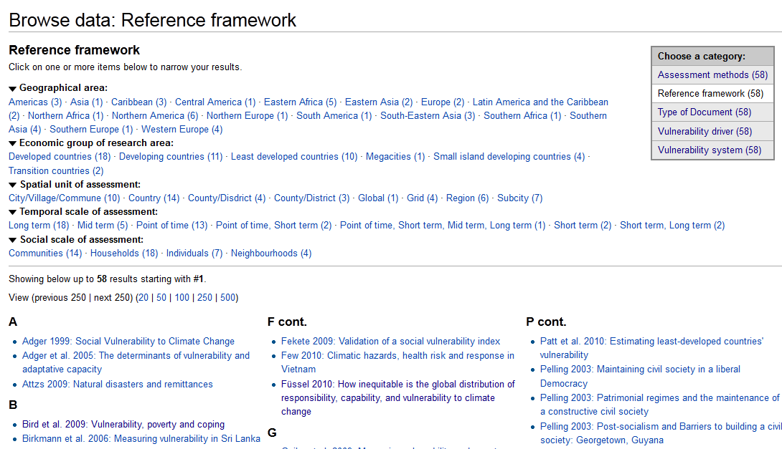
Making Use of the Ontology
Wegner and Khazai 2012

Slide 12
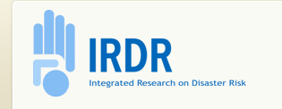
Potential Contribution
Integrated Research on Disaster Risk (IRDR) (ICSU)
International Strategy for Disaster Reduction (ISDR) (United Nations)
Global Facility for Disaster Reduction and Recovery (GFDRR) (World Bank)
Global Network for Disaster Reduction (GNDR)
European Commission
Others……………

Slide 13
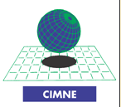
Potential Contributors
Hazards and Vulnerability Research Institute (HVRI) (South Carolina)
Center for Disaster Management and Risk Reduction Technology (CEDIM) (Karlsruhe)
emBRACE Consortium
International Center for Numerical Methods in Engineering (CIMNE) (Barcelona)
Others……………
Notes:
or Potential Partnering Agencies
CEDIM: Karlsruhe Institute of Technology
CCIMNE: Centro Internacional de Metodos Numericos en Ingenieria
Additional Partners: Desinventar, CIESIN/Earth Institute/Columbia Univ, UNEP/GRID and UNDP/GRIP

