Slide 1


International Center of Excellence
(ICoE) Annual Report
Shaw Chen Liu, Director
Research Center for Environmental Changes
Academia Sinica, Taipei China
Chengdu, China
Nov. 6, 2012
Notes:
1
>Founded almost 8 decades ago in 1928, Academia Sinica reaches its present success with the
unceasing support of the government, the diligent research of our cloeagues and the contributions of administrators.
>With the efforts of more than one thousand researcher, both from Taiwan and abroad, Academia Sinica
has earned a worldwide reputation in conducting research in increasingly diverse fields.
>At present, there are 25 research institutes and 5 research centers in Academia Sinica under the three
divisions: Division of Mathematics and Physical Sciences, the Division of Life Sciences and the Division
of the Humanities and Social Sciences.
>As the foremost research institution of Taiwan, the mission of Academia Sinica is more than undertaking in-depth academic research. It also,
>> firstly, promote international cooperation and scholarly exchanges;
>> secondly, cultivate an intellectual environment to nurture young scholars;
>> thirdly, to harness basic research results for applications and technology transfer;
>> finally, to engage the academic and research community within Taiwan toward a modern and
forward-looking collective academic vision.

Slide 2
Goals of ICoE
Goals
Serve as an international platform for conducting integrated research on disaster risk from both the natural and social science perspectives.
Establish a partnership network of disaster reduction research within Taiwan as well as the international scientific community
Promote and coordinate interdisciplinary research on disaster risks at Academia Sinica
Promote and coordinate interdisciplinary research on disaster risks in Taiwan
Serve as an international platform for conducting integrated research on disaster risk (including natural and social sciences)

Slide 3

ICoE
(Also for Center for Sustainability Science, see below)
Organization
  Director: Dr. Chao Han Liu (Academician and VP)
  Executive Secretary: Dr. Yih-Hsiung Yeh
  Deputy Executive Secretary: Dr. Louise L. Y. Wei
  Visiting Senior Research Fellow: Dr. Tony C. Liu
  Program Managers: Si-Yu Yu and Wan-Chun Wu

Slide 4
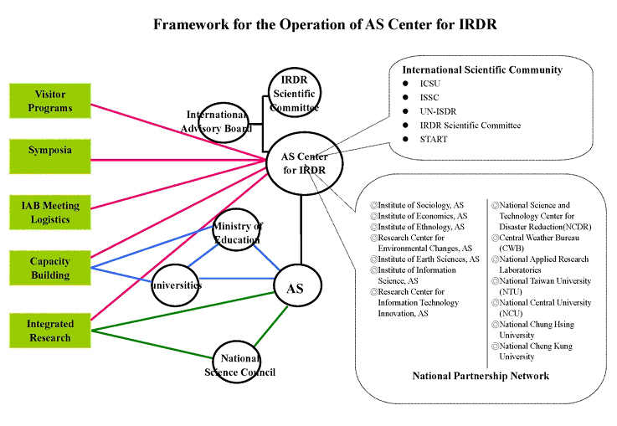

Slide 5
ICoE International Program
Organized Second International Conference on Cities At Risk: Climate Change Risks at Asian Coastal Cities (CARII), April 11-13, 2011 in Academia Sinica.
Hosted two Advanced Institutes (ICoE/START):
    FORIN, March 12-18, 2012
    Data For Coastal Cities at Risk , Oct 22-27, 2012
Co-sponsor the 23rd International CODATA Conference on “Open Data and Information for a Changing Planet”,
Oct 28-31, 2012
IRDR Data for Disaster Loss Workshop, Oct 31 – Nov 2, 2012
Visitor Program
    Dr. Hua-Lu Pan, Physical Parametrization Specialist, NCEP, January to March, 2012
ICoE Domestic Program
Incorporated into the Center for Sustainability Science at Academia Sinica

Slide 6
Center for Sustainability Science
Established on September 1, 2012 at Academia Sinica (Budgeted at US$ 7 millions annually)
Goal
  Conducts sustainability science-related research at Academia Sinica to study the impacts of globe climate change on society and to develop adaptation practices
  Promotes and coordinates interdisciplinary research on sustainability science at Academia Sinica Serves as an international platform for conducting disaster risk reduction research
  Actively participates in major national and international sustainability science related activities
  Services as a think tank for sustainability science at Academia Sinica

Slide 7
How do precipitation extremes change in a warming globe?
I’ve been working on this problem for about15 years, first on the aerosols’ effect on the precipitation.
It turns out that aerosols have little effect on the precipitation, while global warming has a sever detrimental impact on the precipitation intensity (but not much on the total precipitation).
Increases in very heavy precipitation, and sometimes with decreases in light precipitation have been reported in recent years over most land areas (e.g. Karl & Knight, 1998; Liu et al., 2005; Goswami et al., 2006) as well as the tropical oceans (Lau and Wu, 2007).

Slide 8
Increases in heavy precipitation can lead to more and worse floods and mudslides.
Light and moderate precipitation is a critical source of soil moisture and ground water, its reduction increases the risk of droughts.

Slide 9
Changes of precipitation
in Taiwan (1960-2005)
Updated from
Liu et al. (2002)
Hsu & Chen (2002)
also noticed the loss of light rain.

Slide 10
Extreme Precipitation
A significant part of the following results is based on:
Liu, S.C., Congbin Fu, Chein-Jung Shiu, Jen-Ping Chen, and Futing Wu, GRL, 2009.
Shiu, C. J., S. C. Liu, C. Fu, A. Dai, and Y. Sun, GRL, 2012.

Slide 11
How should precipitation intensity change in a warming globe?
Trenberth et al. (2003) hypothesized that the precipitation intensity should increase at about the same rate as atmospheric moisture, i.e. about 7%/K according to the Clausius-Clapeyron equation, because precipitation rates from storms were determined by low-level moisture convergence.
Furthermore, they argued that the increase of heavy rainfalls could even exceed the moisture increase because additional latent heat released from the increased water vapor could feed back and invigorate the storms.

Slide 12
GPCP data, latitudinal variation
(Liu et al., 2009)

Slide 13
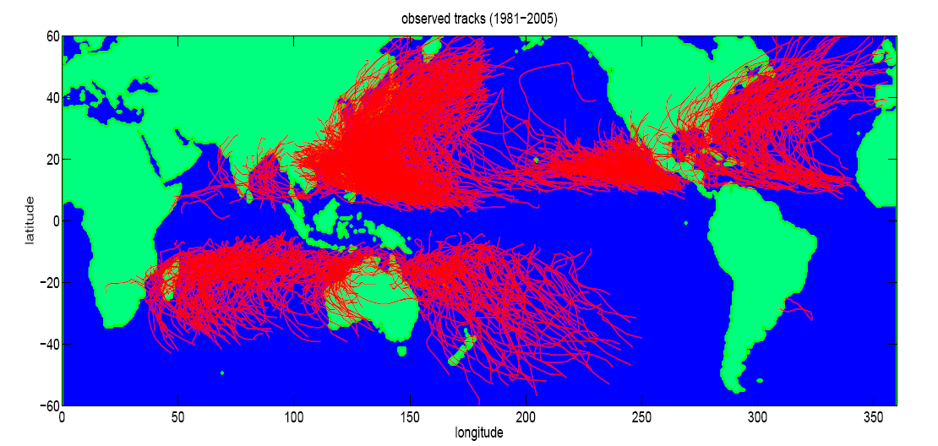

Slide 15
Changes of precipitation intensity in Taiwan as a function of global temperature

Slide 16
Southern China

Slide 17
Adaptation is imperative!
Global warming is already here. Reducing greenhouse gas emissions will need a long time to take effect (~50 years).
Therefore, It is imperative to start adaptation processes, particularly in flood control, drought prevention and water resource management.

Slide 18
THANK YOU
IRDR ICoE
http://irdr-icoe.sinica.edu.tw/

Slide 19
ICoE Future Plan
Host two Advanced Institutes in 2013 (RIA and one TBD)
Conduct visiting scientists and research fellows program
Continue to cooperate with international and domestic organizations to organize symposia, training workshops and other scientific activities
Continue to build a partnership network of disaster reduction research in Taiwan and the international scientific community.
Participate actively in the research activities at the Center for Sustainable Science at AS

Slide 20
From Liu et al. (GRL, 2009)

